Slide 1


Maria Granel Customer Satisfaction
António Fonseca r20181154
Gonçalo Calixto r20181075
João Correia r20181076
Lucas Lopes r20181111
Tiago Sousa r20181077
Tomás Ricardo r20181113

Slide 2

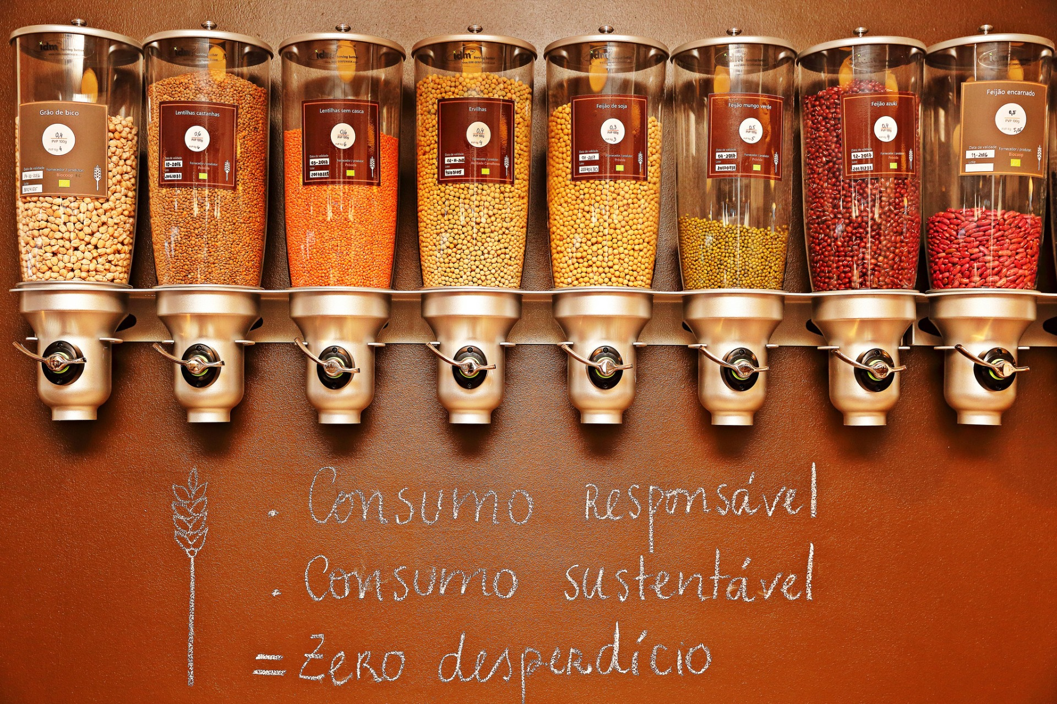

Contents
Target Population
1
Problem
2
Decision Alternative, Decision Criteria and Decision Rules

Slide 3
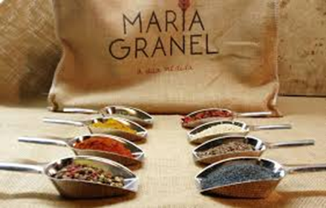
Contents
Sampling Plan
3
Results
4
Conclusions and Recommendations

Slide 4


Target Population
People who, in the last 3 months (September 2020 - November 2020), have bought at least one item in Maria Granel.
Above 16 years old.

Slide 5
Problem
Problem
Decision Criteria
Decision Rules
Decision Alternatives
What can Maria Granel do to increase customer satisfaction?
How to reach and bring more people to Maria Granel while maintaining their sustainable standards?

Slide 6
Decision Alternatives
Problem
Decision Criteria
Decision Rules
Decision Alternatives
Implement new changes/services? Yes or No.

Slide 7
Decision Criteria
Problem
Decision Criteria
Decision Rules
Decision Alternatives
Agreeing with the implementation of at least one of the measures.

Slide 8
Decision Rules
Problem
Decision Criteria
Decision Rules
Decision Alternatives
If 51% of the clients agree with the implementation of a measure related to physical stores, new products and services, it will be implemented.

Slide 9
Decision Rules
Problem
Decision Criteria
Decision Rules
Decision Alternatives
If 65% of the clients agree with the implementation of a measure related to the online store, it will be implemented.

Slide 10

Sampling Plan (ideal study)
Stratified Random Sampling
using
Probabilistic Sampling
Sample Selection
CATI
+
RDD
Data Collection
Motivate interviewers to give honest answers
Correctly upload answers to the software
Fieldwork

Slide 11
Sampling Plan (our study)
Convenience Sampling
using
Social Networks and close contacts
Sample Selection
CAWI
+
Google Forms
Data Collection
Self Administrated Questionnaires
Published Online
Fieldwork

Slide 12
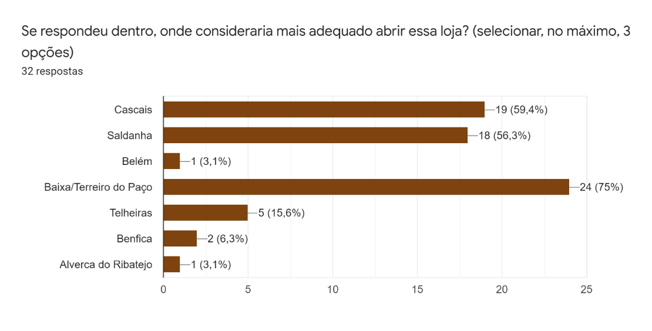
Results Physical Stores
Cascais
Saldanha
Baixa/Terreiro do Paço

Slide 13
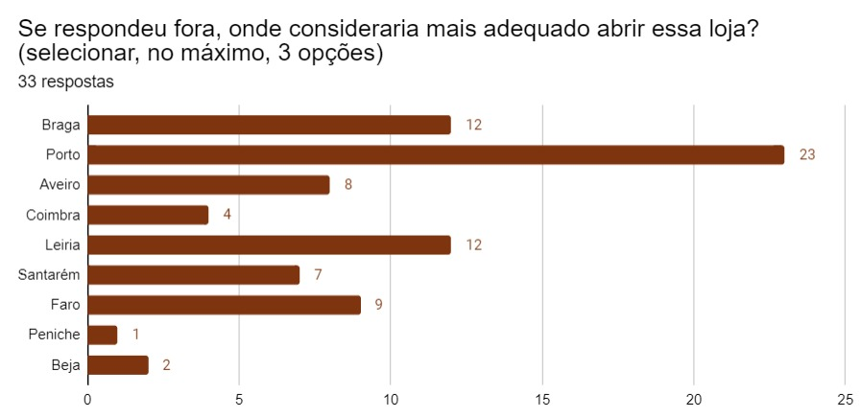
Results Physical Stores
Porto

Slide 14
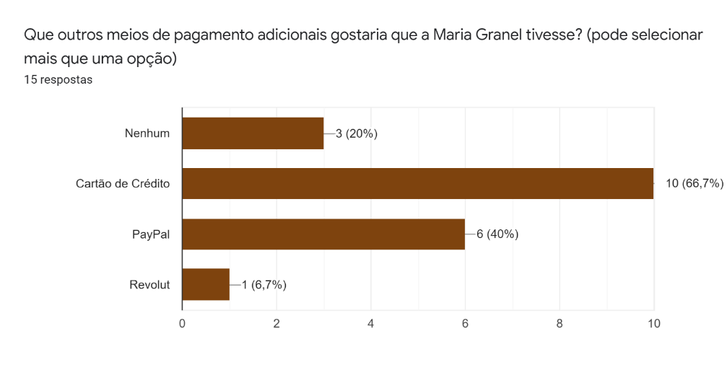
Results Online Stores
Credit Card

Slide 15
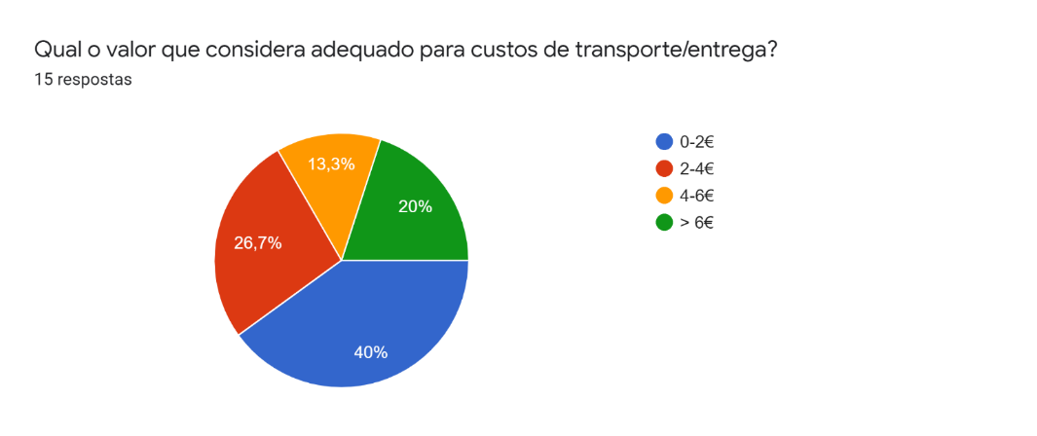
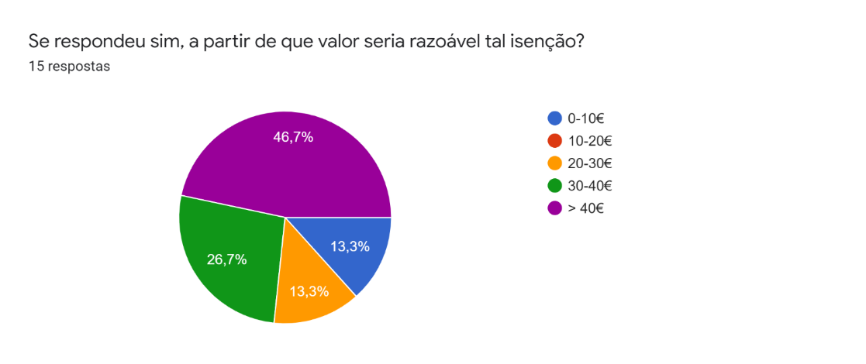
Results Online Stores
Maximum Value: 2€
Recommended Threshold: >30€

Slide 16
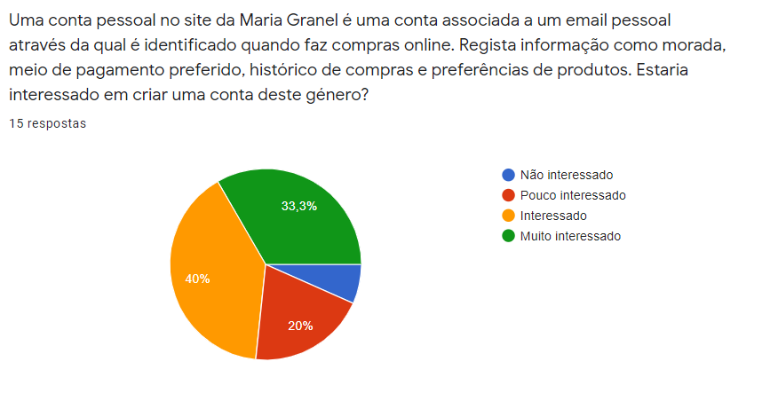
Results Online Stores
Implementation of Personal Accounts.

Slide 17
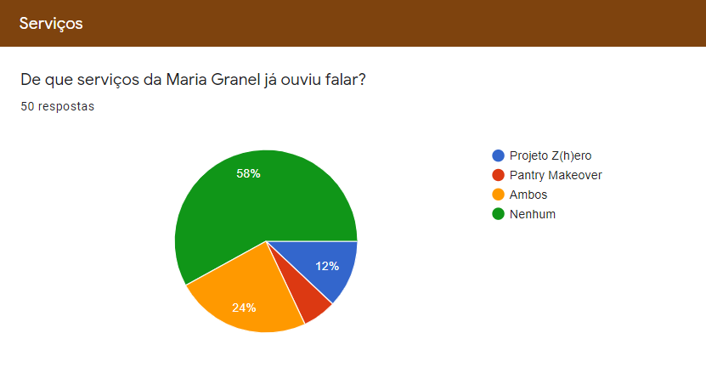
Results Services

Slide 18
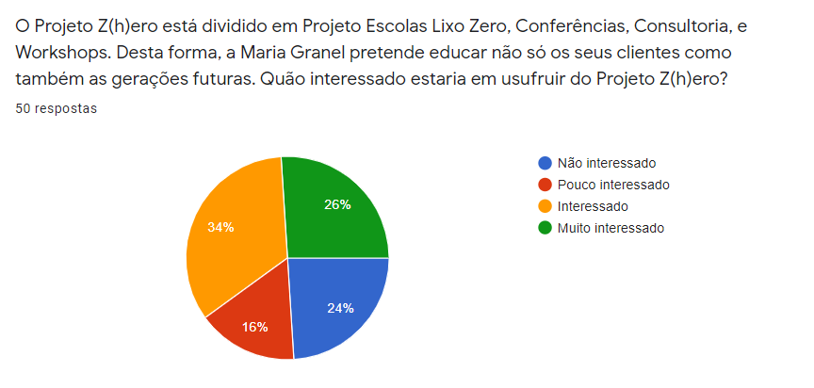
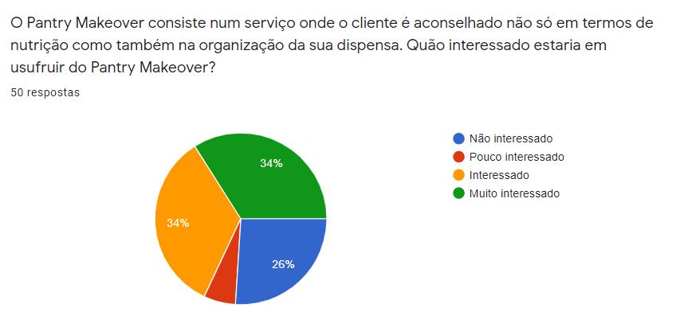
Results Services
Promote both services.

Slide 19
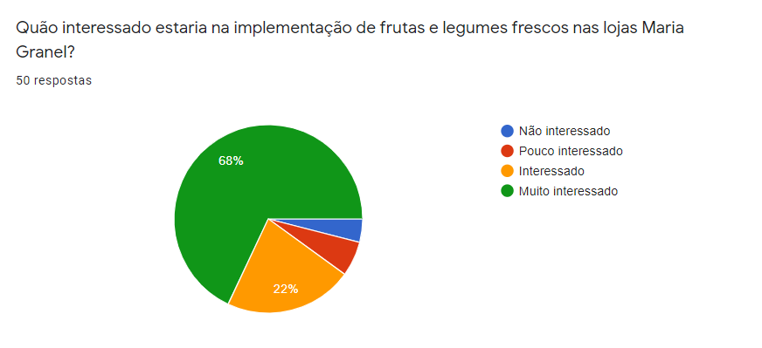
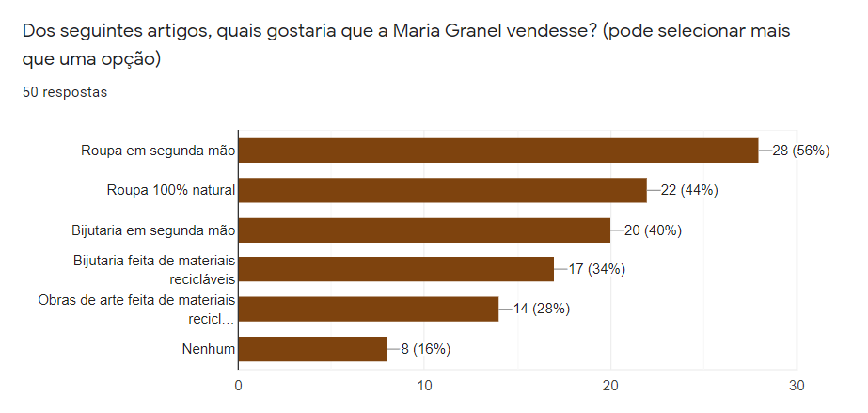
Results New Products
Introduce new products:
Fruits and vegetables;
Second-hand clothes.

Slide 20
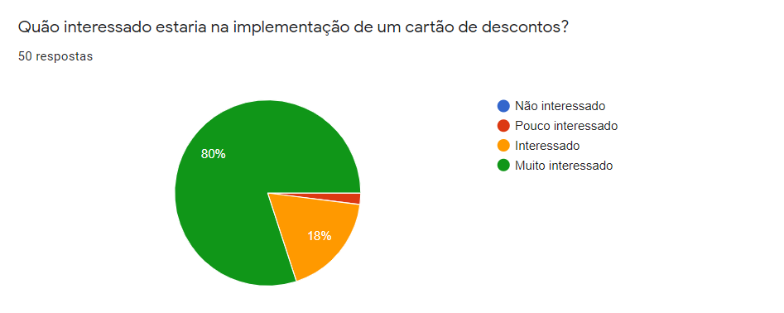
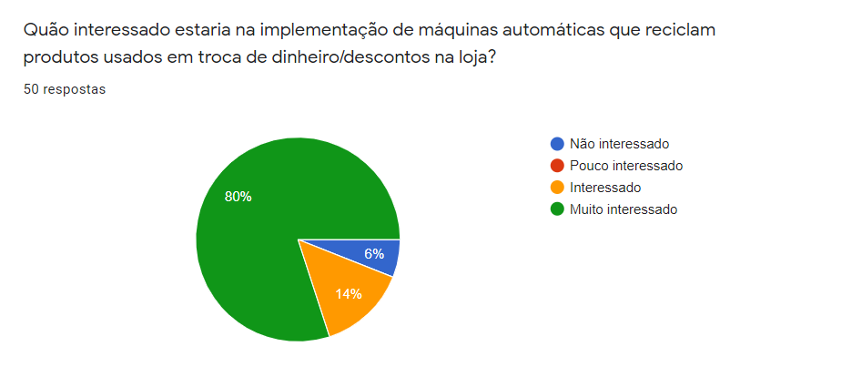
Results New Products
Introduce new products:
Discount card;
Recycling Machine.

Slide 21
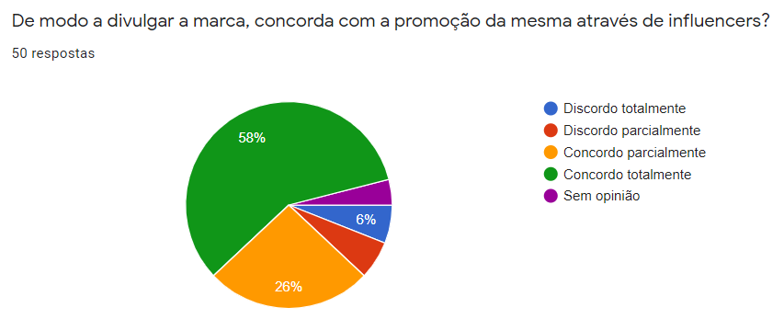
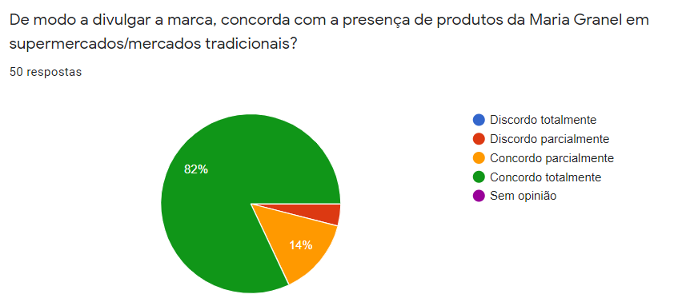
Results Other Measures
Advertise through Influencers on Social Networks.
Advertise by being present in traditional supermarkets.

Slide 22
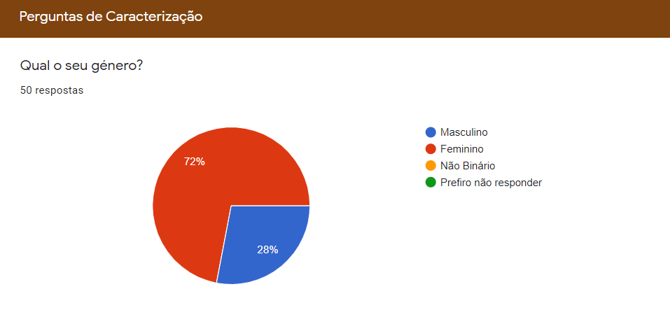
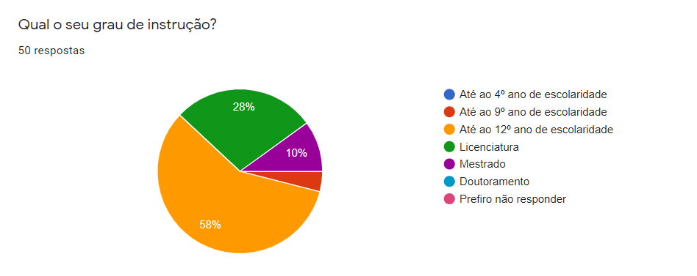
Results Characterization Questions
Female dominated customer base;
Almost every client has studied at least until the 12th grade.

Slide 23
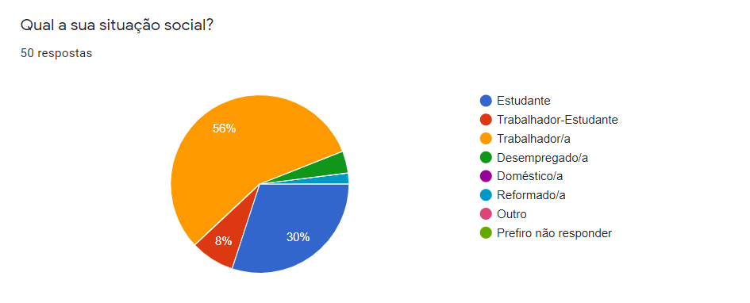
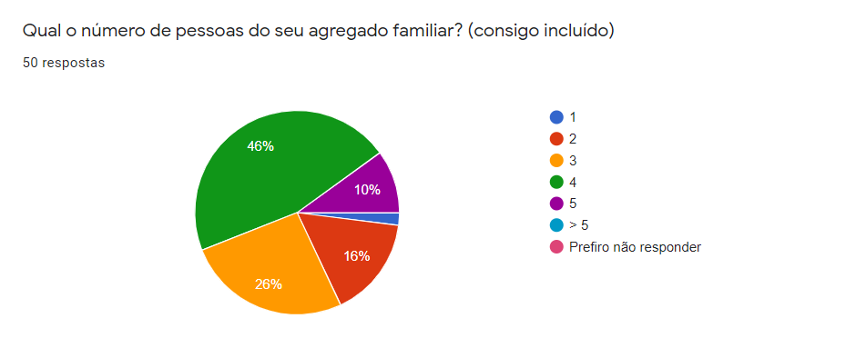
Results Characterization Questions
More than half of the interviewees are workers;
Diversified sample in terms of nº individuals per household.

Slide 24
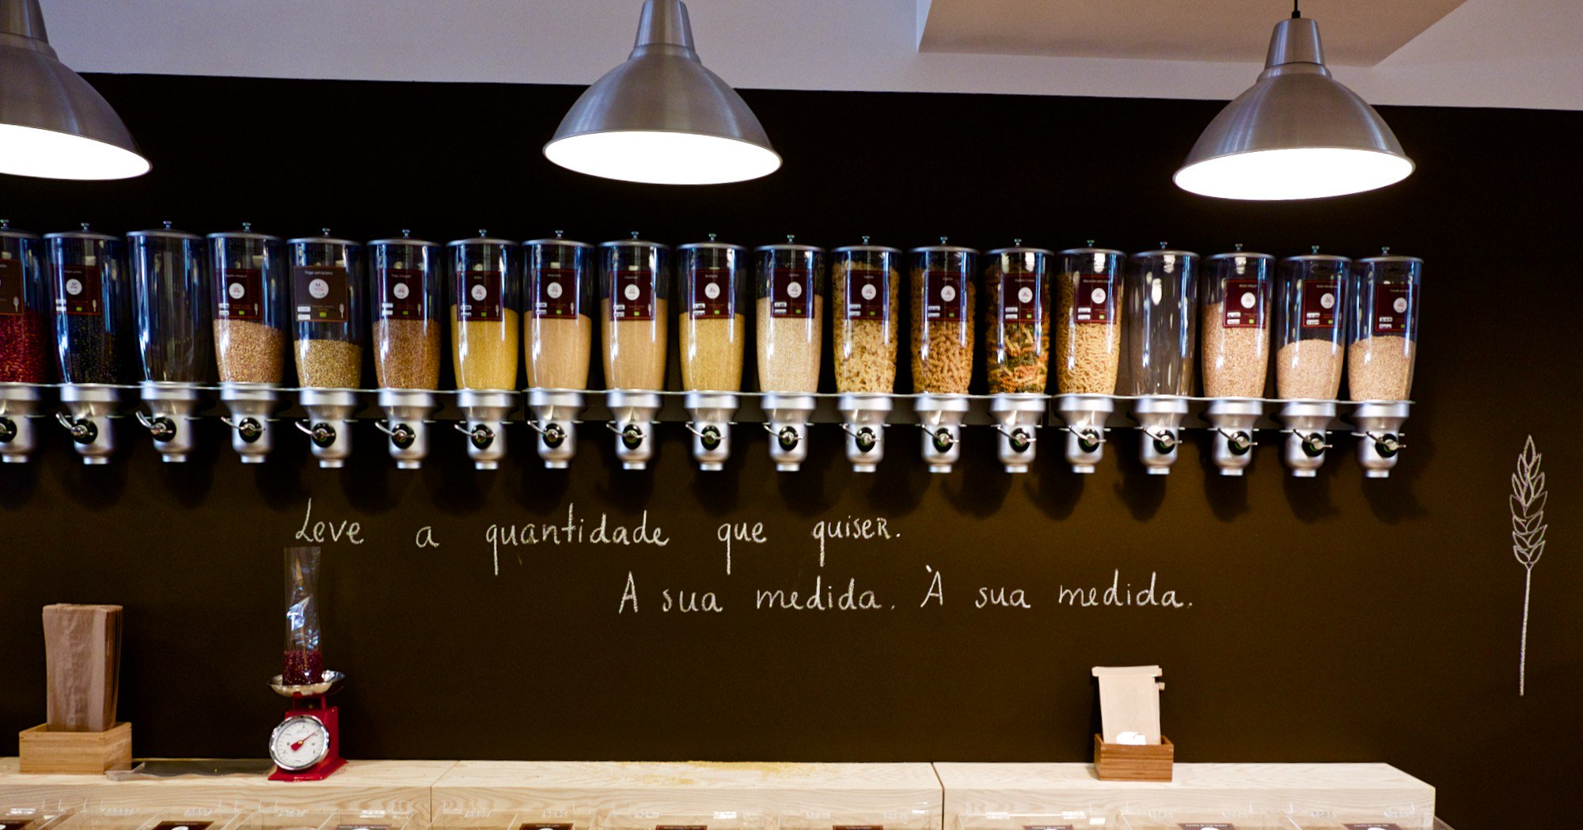
Thank you for your attention!

